Slide 1
Computer Graphics:
Line Drawing Algorithms
Scan Conversion Algorithms

Slide 2
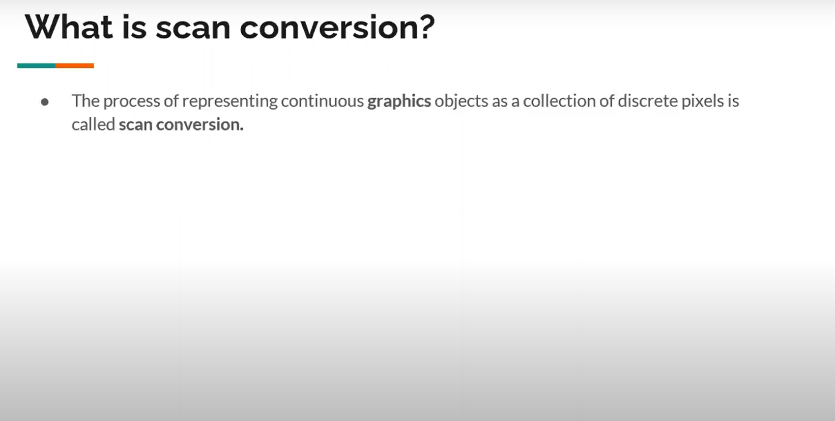

Slide 3
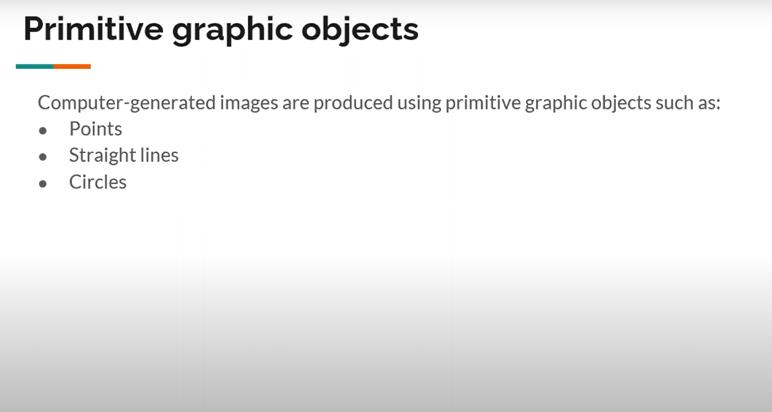

Slide 4
Contents
Graphics hardware
The problem of scan conversion
Considerations
Line equations
Scan converting algorithms
  A very simple solution
  The DDA algorithm
Conclusion

Slide 5
The Problem Of Scan Conversion
A line segment in a scene is defined by the coordinate positions of the line end-points
y
(7, 5)
(2, 2)
x

Slide 6
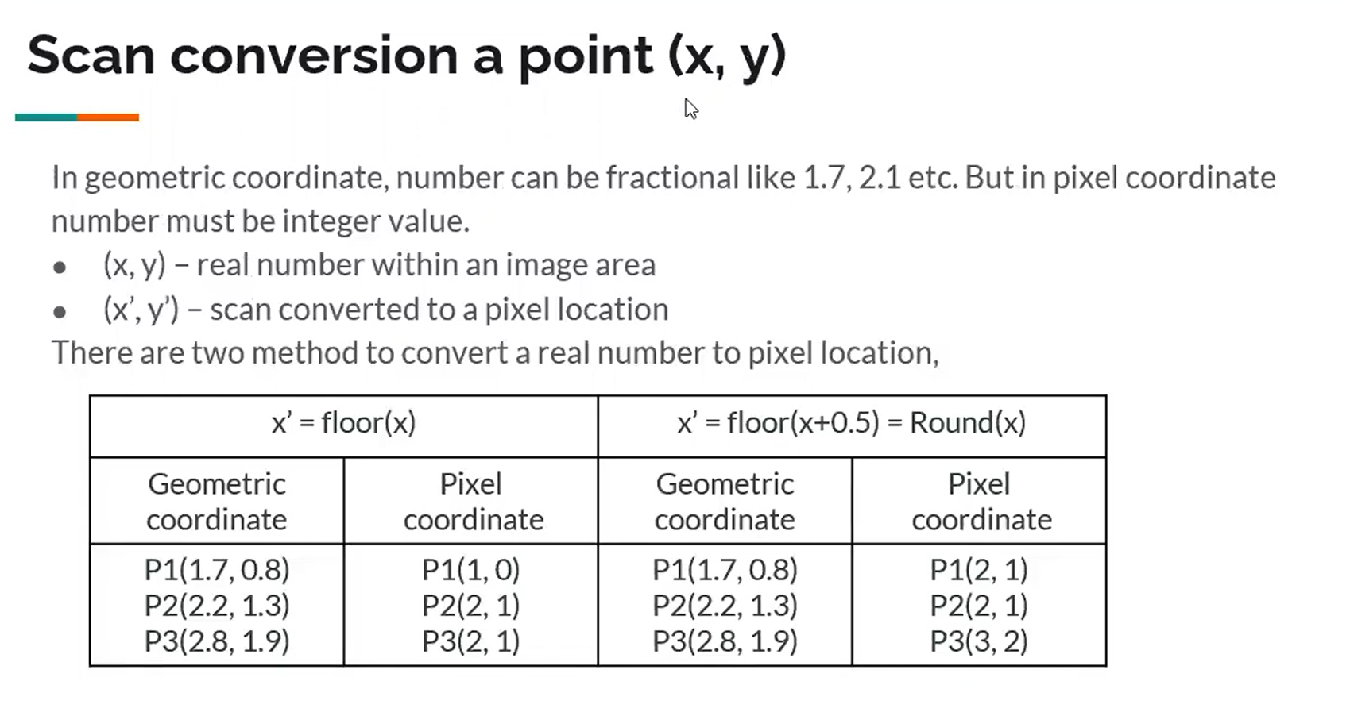

Slide 7
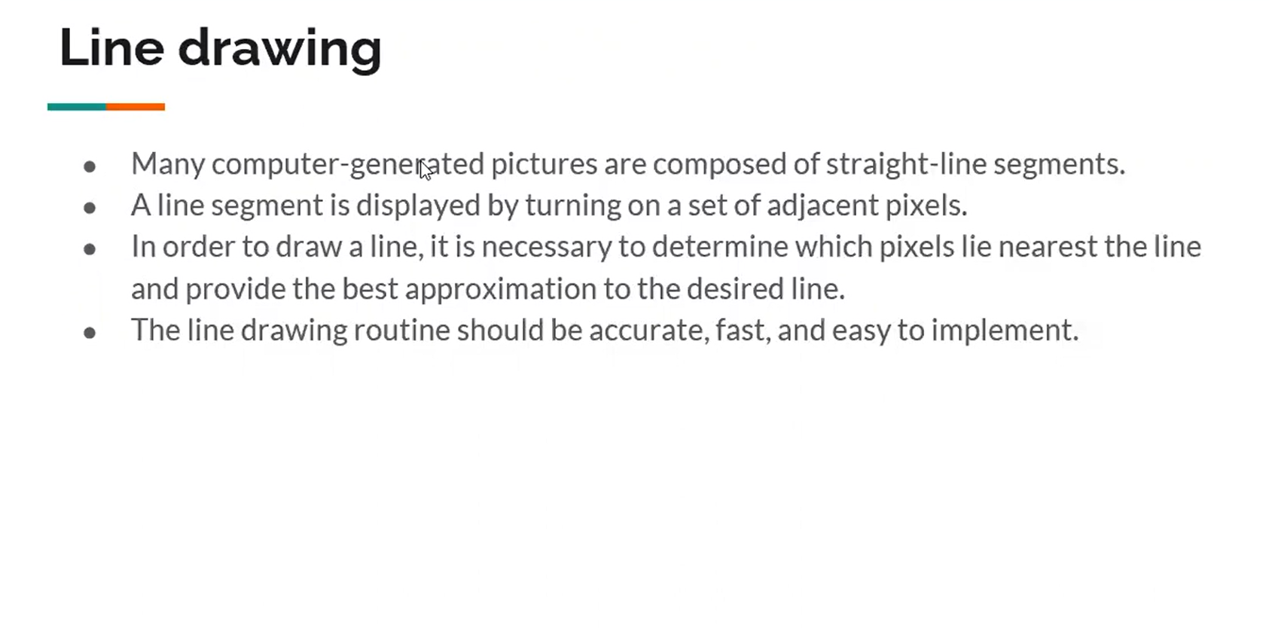

Slide 8
The Problem (cont…)
But what happens when we try to draw this on a pixel based display?
How do we choose which pixels to turn on?

Slide 9
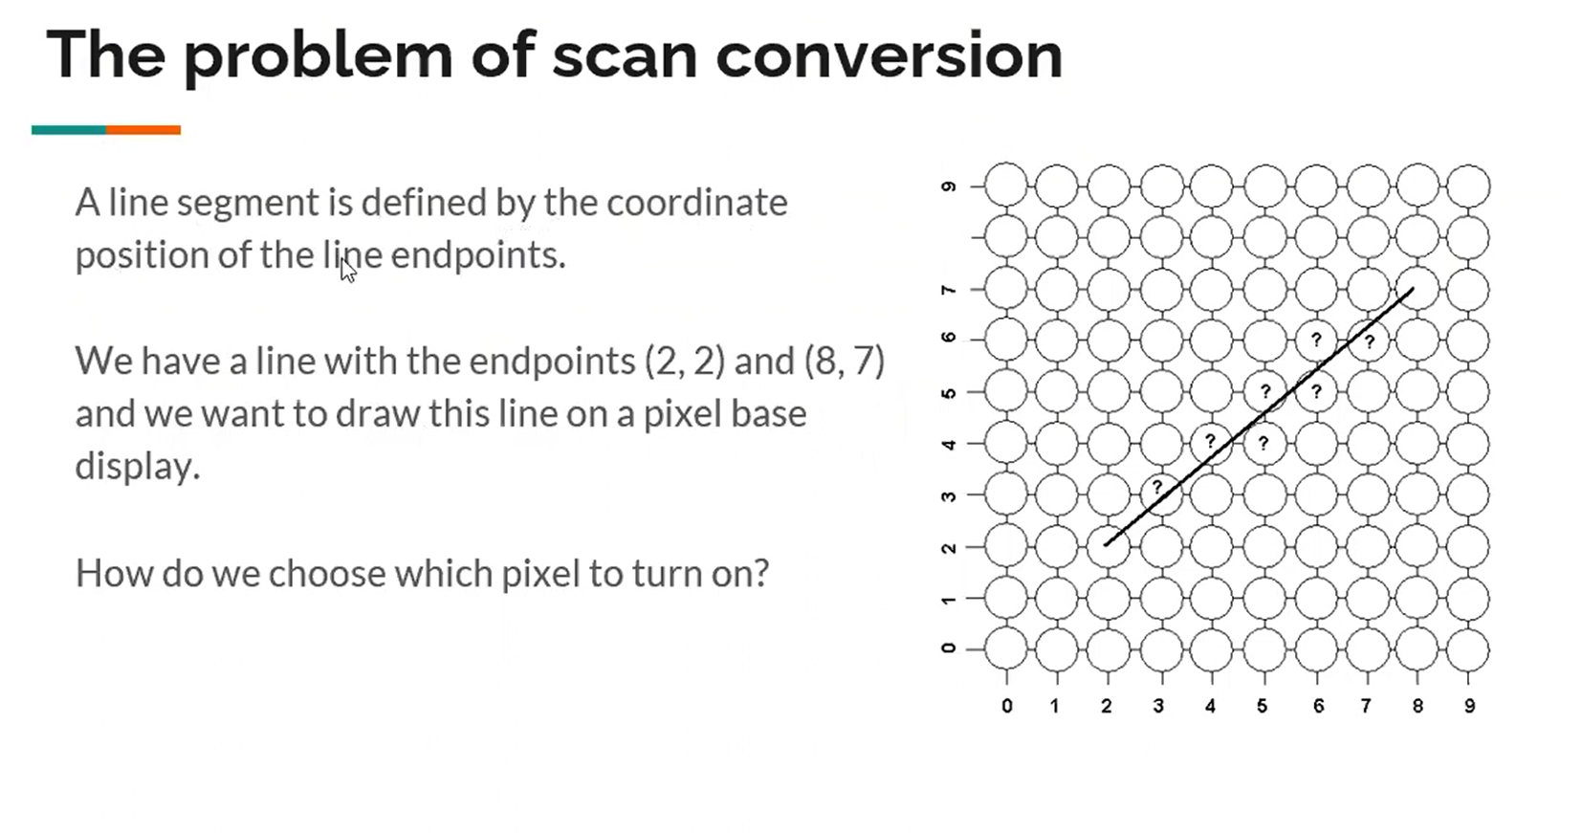

Slide 10
Considerations
Considerations to keep in mind:
  The line has to look good
    Avoid jaggies
  It has to be lightening fast!
    How many lines need to be drawn in a typical scene?
    This is going to come back to bite us again and again

Slide 11
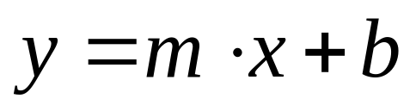
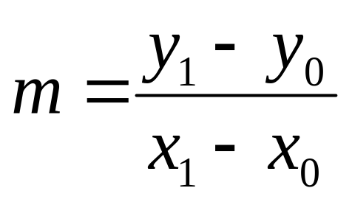
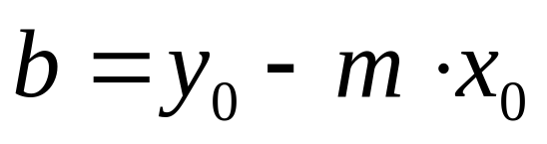
Line Equations
Let’s quickly review the equations involved in drawing lines
Slope-intercept line equation:
y
y₁
where:
y₀
x₀
x₁
x

Slide 12
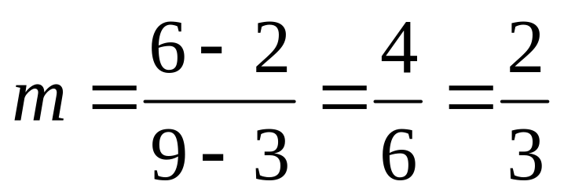
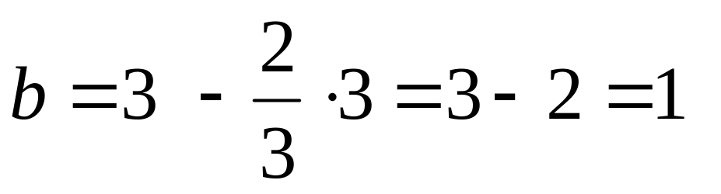
Line Equations
Let’s quickly review the equations involved in drawing lines
Slope-intercept line equation:
y
(9, 6)
y₁
where:
y₀
(3, 2)
x₀
x₁
x

Slide 13
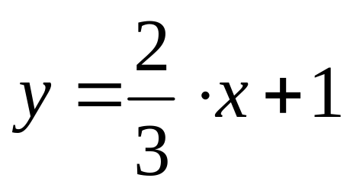
Line Equations
Let’s quickly review the equations involved in drawing lines
Slope-intercept line equation:
y
(9, 6)
y₁
where:
y₀
(3, 2)
x₀
x₁
x

Slide 14
A Very Simple Solution
We could simply work out the corresponding y coordinate for each unit x coordinate
Let’s consider the following example:
y
(7, 5)
5
2
(2, 2)
2
7
x

Slide 15
A Very Simple Solution (cont…)
5
4
3
2
1
0
0
1
2
3
4
5
6
7

Slide 16
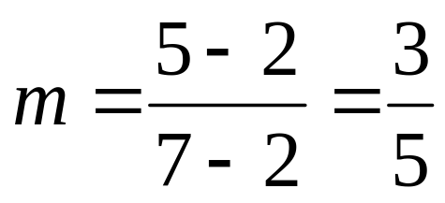
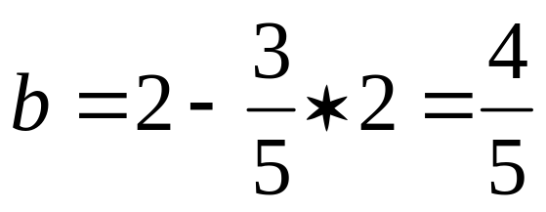
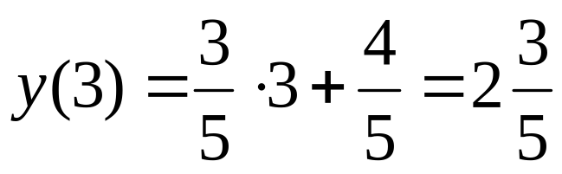
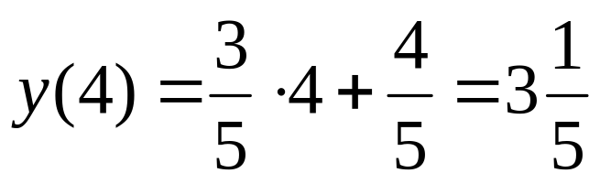
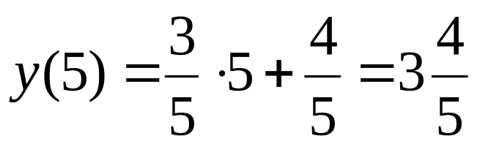
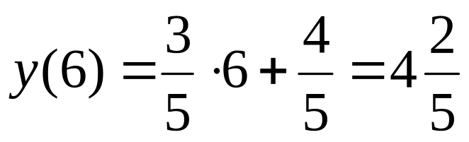
A Very Simple Solution (cont…)
y
(7, 5)
First work out m and b:
5
2
(2, 2)
2
3
4
5
6
7
x
Now for each x value work out the y value:

Slide 17
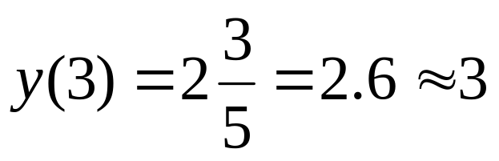
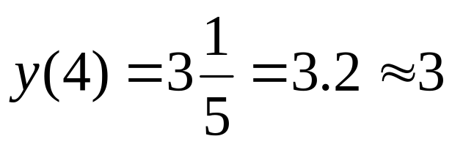
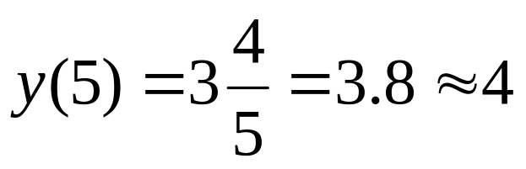
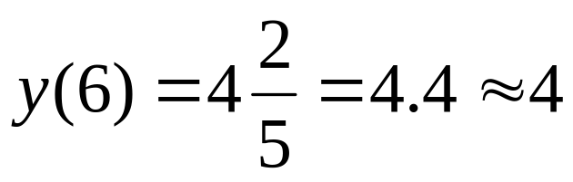
A Very Simple Solution (cont…)
Now just round off the results and turn on these pixels to draw our line
Pixel
(3, 3)
(4,3)
(5,4)
(6,4)
7
6
5
4
3
2
1
0
0
1
2
3
4
5
6
7
8

Slide 18
A Very Simple Solution (cont…)
However, this approach is just way too slow
In particular look out for:
  The equation y = mx + b requires the multiplication of m by x
  Rounding off the resulting y coordinates
We need a faster solution

Slide 19
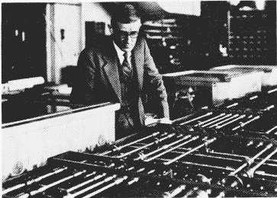
The DDA Algorithm
The digital differential analyzer (DDA) algorithm takes an incremental approach in order to speed up scan conversion
Simply calculate y_{k+1} based on y_{k}
The original differential analyzer was a physical machine developed by Vannevar Bush at MIT in the 1930’s in order to solve ordinary differential equations.
More information here.

Slide 20
The DDA Algorithm (cont…)
Consider the list of points that we determined for the line in our previous example:
(2, 2), (3, 2³/₅), (4, 3¹/₅), (5, 3⁴/₅), (6, 4²/₅), (7, 5)
Notice that as the x coordinates go up by one, the y coordinates simply go up by the slope of the line
This is the key insight in the DDA algorithm

Slide 21
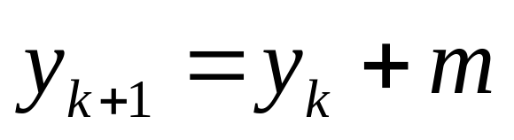
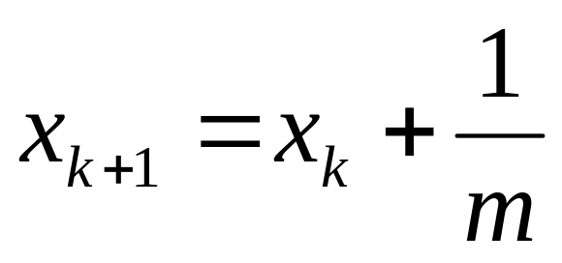
The DDA Algorithm (cont…)
When the slope of the line is between -1 and 1 begin at the first point in the line and, by incrementing the x coordinate by 1, calculate the corresponding y coordinates as follows:
When the slope is outside these limits, increment the y coordinate by 1 and calculate the corresponding x coordinates as follows:

Slide 22
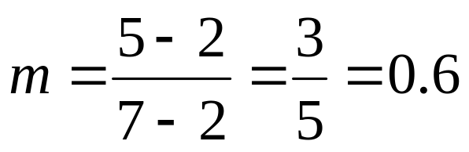
DDA Algorithm Example
Let’s try out the following examples:
y
x(+1) | y(+m) | y(roundoff) | pixel
2 | 2
3 | 2.6 | 3 | (3, 3)
4 | 3.2 | 3 | (4, 3)
5 | 3.8 | 4 | (5, 4)
6 | 4.4 | 4 | (6, 4)
(7, 5)
5
2
(2, 2)
2
7
x

Slide 23
DDA Algorithm Example (cont…)
7
6
5
4
3
2
0
1
2
3
4
5
6
7

Slide 24
DDA Algorithm Example (cont…)
7
6
5
4
3
2
0
1
2
3
4
5
6
7

Slide 25
The DDA Algorithm (cont…)
Again the values calculated by the equations used by the DDA algorithm must be rounded to match pixel values
(x_{k}+1, round(y_{k}+m))
(round(x_{k}+ ¹/_{m}), y_{k}+1)
(x_{k}, y_{k})
(x_{k}+ ¹/_{m}, y_{k}+1)
(x_{k}+1, y_{k}+m)
(x_{k}, y_{k})
(x_{k}, round(y_{k}))
(round(x_{k}), y_{k})

Slide 26
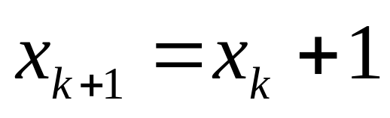
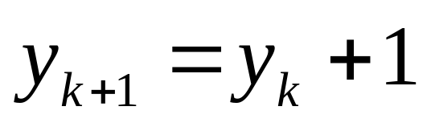
The DDA Algorithm (cont…)
If -1<m<1 then
Then roundoff y.
Otherwise,
Then roundoff x.

Slide 27
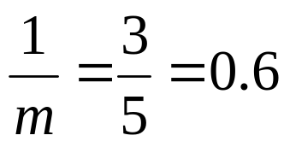
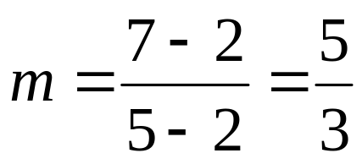
DDA Algorithm Example
Let’s try out the following examples:
y
(5, 7)
y(+1) | x(+1/m) | x(roundoff) | pixel
2 | 2
3 | 2.6 | 3 | (3, 3)
4 | 3.2 | 3 | (3, 4)
5 | 3.8 | 4 | (4, 5)
6 | 4.4 | 4 | (4, 6)
5
2
(2, 2)
2
7
x

Slide 28
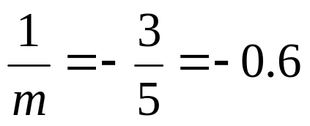
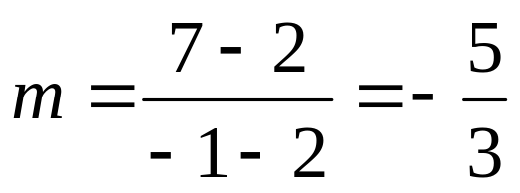
DDA Algorithm Example
Let’s try out the following examples:
y
(-1, 7)
y(+1) | x(+1/m) | x(roundoff) | pixel
2 | 2
3 | 1.4 | 1 | (1, 3)
4 | 0.8 | 1 | (1, 4)
5 | 0.2 | 0 | (0, 5)
6 | -0.4 | 0 | (0, 6)
(2, 2)
2
7
x

Slide 29
The DDA Algorithm Summary
The DDA algorithm is much faster than our previous attempt
  In particular, there are no longer any multiplications involved
However, there are still two big issues:
  Accumulation of round-off errors can make the pixelated line drift away from what was intended
  The rounding operations and floating point arithmetic involved are time consuming

Slide 30
Exercise
1. Find out m and b and the equation of the following lines whose endpoints are given:
(20, 35), (9, 50)
(-5, 50), (-5,0)
(-10, 10), (48, 24)
2. Using DDA algorithm find out the first 5 pixels of the lines whose endpoints are given:
(20, 5), (19, 50)
(-5, 50), (-15,0)
(-10, -10), (48, 24)

